Slide 1
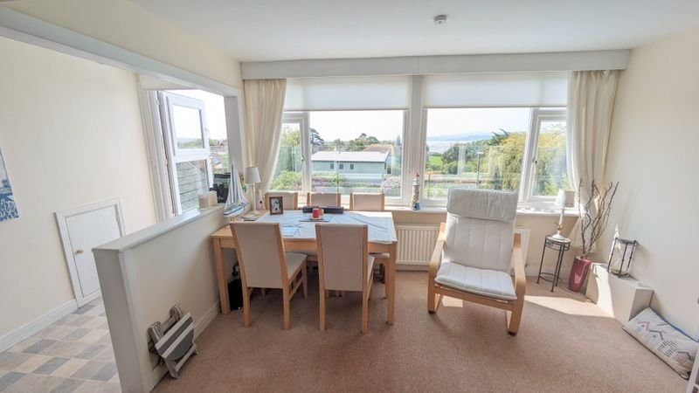
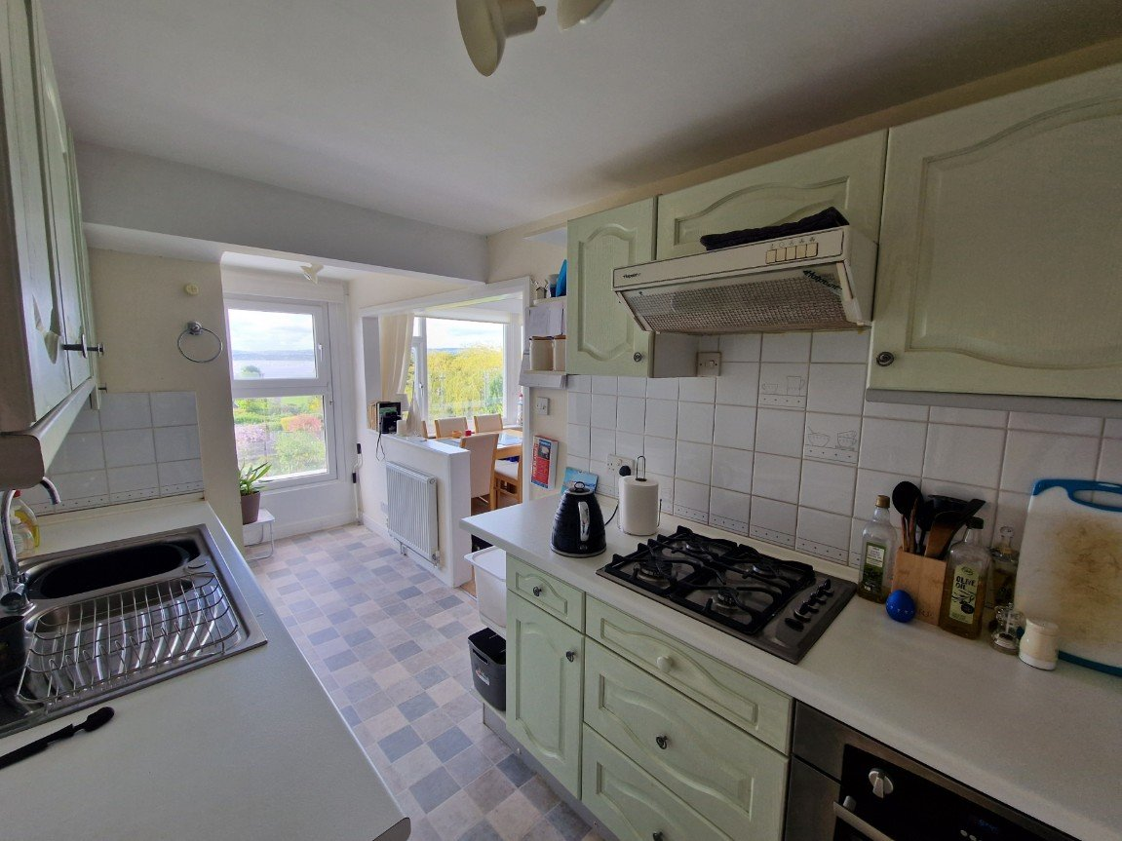
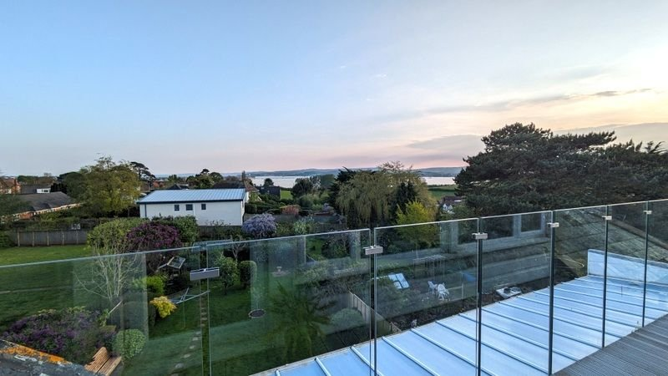
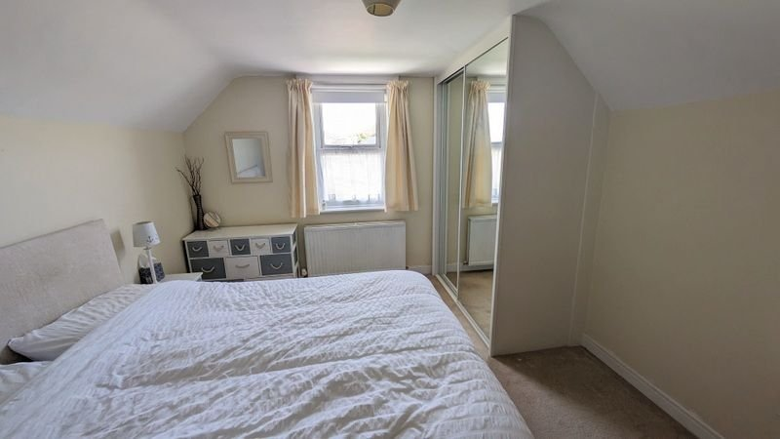
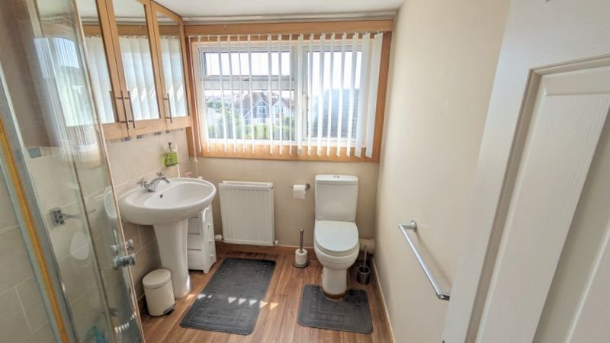
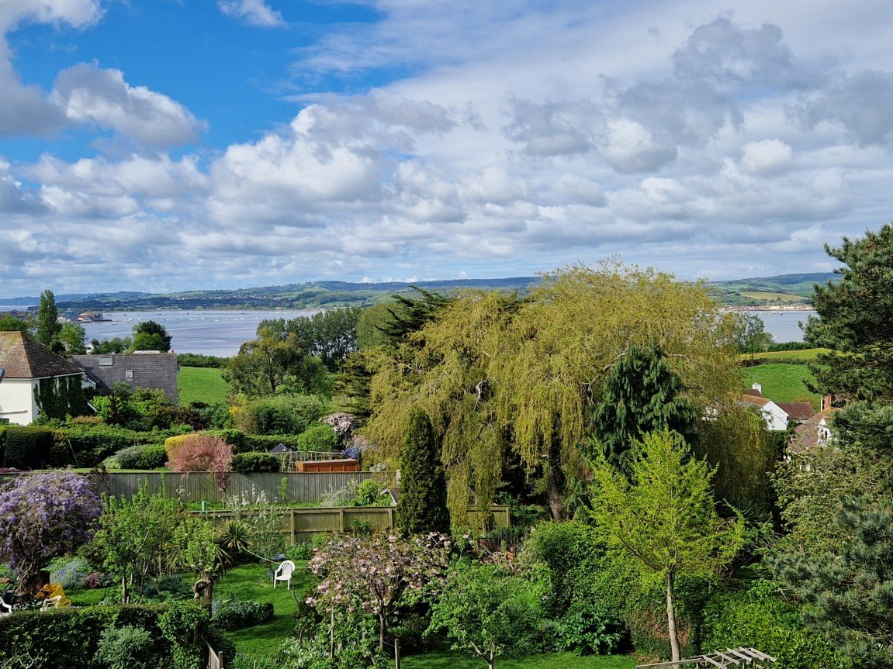
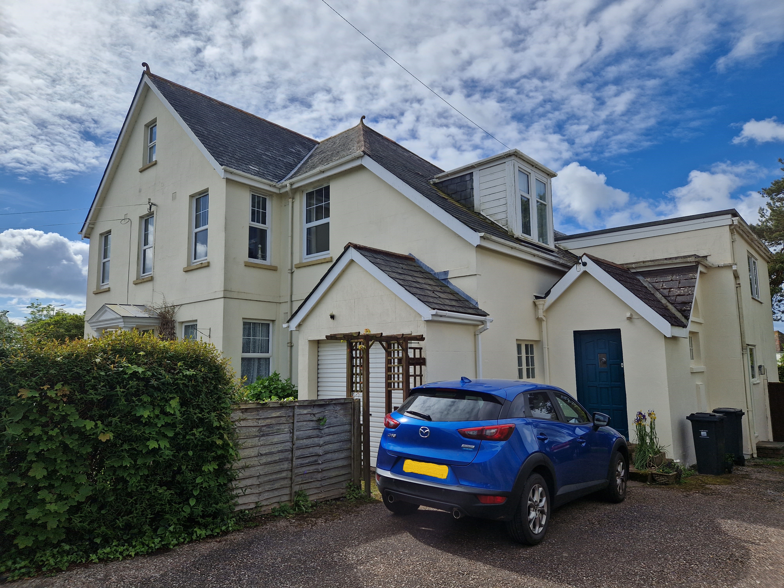
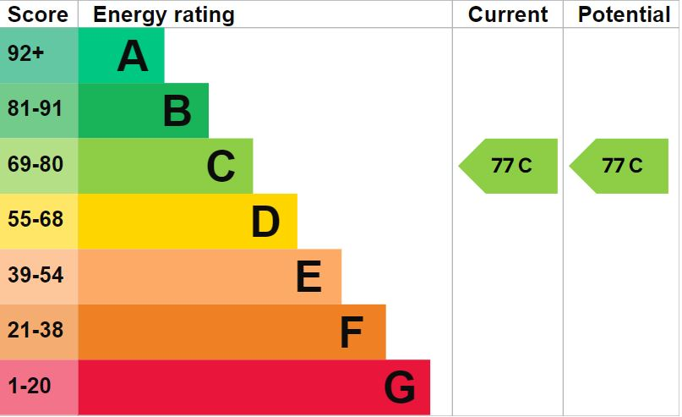
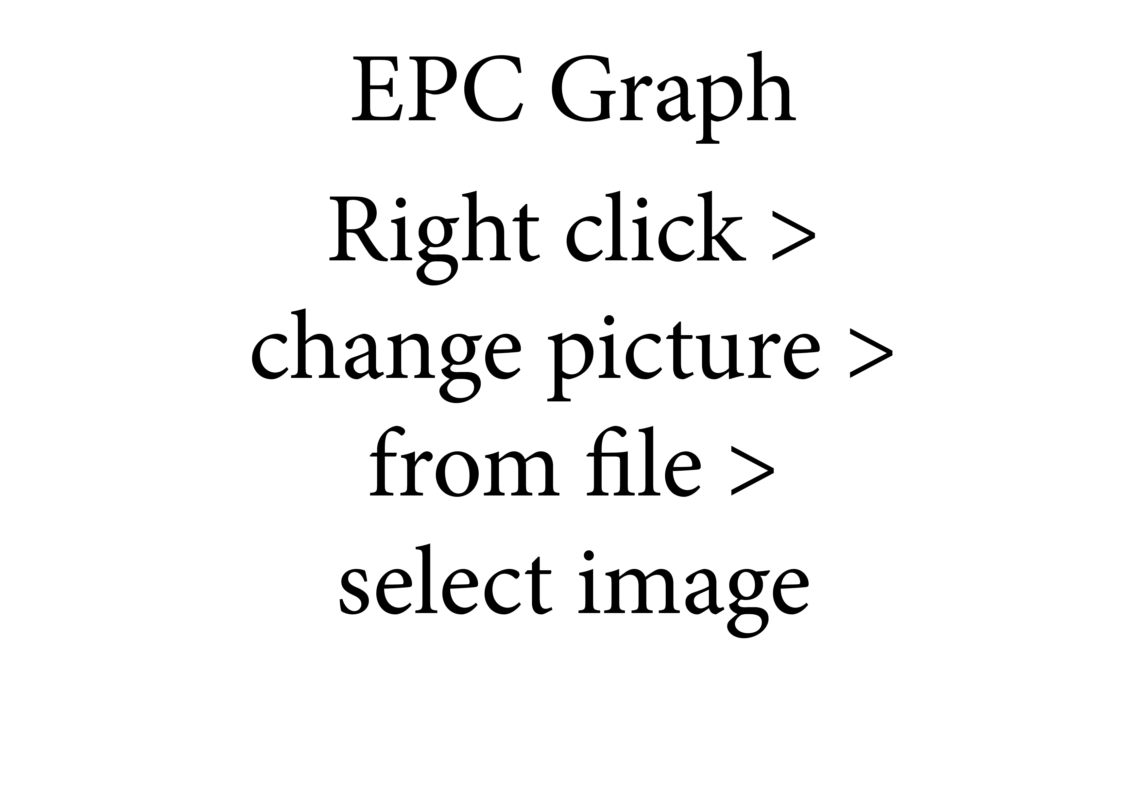
www.pennys.net
Flat 3, 247 Exeter Road, Exmouth, Devon, EX8 3NG
OFFERS IN EXCESS OF: £205,000
TENURE Leasehold
An Individual Maisonette Style Apartment Forming Part Of A Period Detached Building With Wonderful Coastal Views
Kitchen with Access out onto Glass Walled Balcony •
Lounge/Dining Room with Stunning Views • Shower Room/WC •
Occasional Second Bedroom/Study • Galleried Hallway/Landing Area •
Parking Space • Close to Shops and Bus Routes •
Viewing Recommended •
Pennys Estate Agents Limited for themselves and for the vendor of this property whose agents they are give notice that:- (1) These particulars do not constitute any part of an offer or a contract. (2) All statements contained in these particulars are made without responsibility on the part of Pennys Estate Agents Limited. (3) None of the statements contained in these particulars are to be relied upon as a statement or representation of fact. (4) Any intending purchaser must satisfy himself/herself by inspection or otherwise as to the correctness of each of the statements contained in these particulars. (5) The vendor does not make or give and neither do Pennys Estate Agents Limited nor any person in their employment has any authority to make or give any representation or warranty whatever in relation to this property.
PENNYS ESTATE AGENTS
2 Rolle House, Rolle Street, Exmouth, Devon, EX8 2SN
Tel: 01395 264111 EMail: help@pennys.net

Slide 2
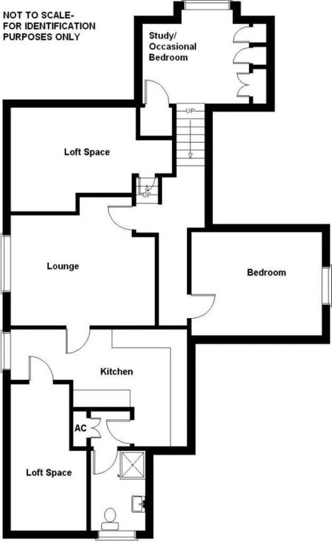
Flat 3, 247 Exeter Road, Exmouth, Devon, EX8 3NG
THE ACCOMODATION COMPRISES: This SECOND FLOOR MAISONETTE is one of three units created from a substantial detached property located off the Exeter Road, about a mile from the Town Centre. Worthy of particular note is the stunning glass walled balcony set off of the kitchen which enjoys very far reaching views to the sea, Haldon Hills and beyond.
DIRECTIONS: The property is located on your left hand side down a private lane off the A376 Exeter to Exmouth Road opposite Featherbed Lane.
ENTRANCE: Communal entrance door to GROUND FLOOR LOBBY with stairs rising to a FIRST FLOOR LANDING. Own front door to:
STUDY/OCCASIONAL BEDROOM: 3.96m x 2.44m (13'0" x 8'0") Sloping ceiling with uPVC double glazed dormer window; built in cupboard; stairs rising to:
SECOND FLOOR LANDING: Wrought iron balustrade; radiator; access to large storage area which is fully boarded; telephone point; doors to:
LOUNGE: 4.27m x 3.51m (14'0" x 11'6") plus 2'2 (0.66m) recess. Open plan design to the kitchen also creating a beautiful airy feel of space throughout; large uPVC window offering spectacular views of the Exe Estuary and South Devon coastline to Berry Head; radiator; television point; open plan design to:
L SHAPED KITCHEN: 5.38m x 2.9m (17'8" x 9'6") Narrowing to 6'2 (1.88m) uPVC double glazed doorway opening onto STUNNING GLASS WALLED BALCONY; part tiled walls; work surfaces with inset one and a half bowl sink unit; range of base and eye level units; inset four burner gas hob with built in electric oven and filter hood; plumbing for an automatic washing machine; further appliance spaces for both fridge and a freezer; radiator; eaves storage cupboard; door to:
INNER LOBBY: Worcester gas fired boiler serving domestic hot water and central heating; door to:
SHOWER ROOM/WC : 2.21m x 1.7m (7'3" x 5'7") With glazed corner shower cubicle with both an over head and hand held shower unit; pedestal wash hand basin; WC with push button flush; attractive part wall tiling; radiator; mirrored cabinet; double glazed window.
BEDROOM ONE: 4.06m x 3.25m (13'4" x 10'8") Double glazed window; built in mirror fronted double wardrobes; radiator.
OUTSIDE: Parking space allocated to the flat on the left-hand side of driveway.
TENURE/OUTGOINGS: The property is held on a 200 year lease from 18th August 1977 with 154 years remaining. We understand the maintenance is 20% contribution towards maintenance costs on an 'as and when basis' and a ground rent of £50 per annum. The property will also benefit from a third share of the freehold title on completion.
AGENTS NOTE: No holiday lets are permitted under the lease. Normal residential lets are permitted. Pets are permitted with permission of the freeholder.
DIRECTIONS: The property is located on your left hand side down a private lane off the A376 Exeter to Exmouth Road opposite Featherbed Lane.
MORTGAGE ASSISTANCE: We are pleased to recommend Meredith Morgan Taylor, who would be pleased to help irrelevant of which estate agent you finally buy through. For a free initial, no obligation chat please contact us on 01395 264111 to arrange an appointment.
FLOOR PLAN:

